Slide 1

Sports Analytics III
Produced by Dr. Mario
UNC STOR 390

Slide 2
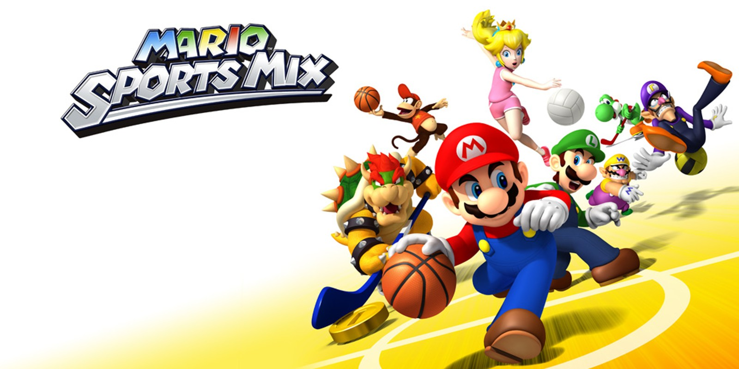
Analytics Across the Organizations
Sports Analytics Use Survey (2013)
Sample of 27 People (NFL, MLB, NBA, EPL)
How Many Different Sources?
1-2 (6.7%)
3-4 (33.3%)
5-6 (13.3%)
>6 (46.71%)

Slide 3
Analytics Across the Organizations
How Much Data is Centralized?
All (31.3%)
Most (37.4%)
Some (31.3%)
How Much Data is Dependent on One Person?
Some (50.0%)
Most (43.7%)
All Data Centralized (6.3%)

Slide 4
Analytics Across the Organizations
Is Data Checked for Errors?
Always (31.3%)
Usually (37.5%)
Sometimes (18.8%)
Occasionally (6.1%)
Rarely (6.3%)
How Many Database Programmers are Employed?
0 (37.5%)
1-2 (50.0%)
3-4 (0.0%)
>5 (12.5%)

Slide 5
Analytics Across the Organizations
How Many Statistical Analysts are Employed?
0 (20.0%)
1-2 (66.6%)
3-4 (0.0%)
>5 (13.3%)
Roadblock: Difficulty Identifying Strong Applicant
Difficulty in Both Hiring and Evaluating

Slide 6
Analytics Across the Organizations
Clear Process for Hiring/Evaluating Analysts
Strongly Agree (13.3%/14.3%)
Somewhat Agree (13.3%/14.3%)
Neutral (26.7%/28.6%)
Somewhat Disagree (13.4%/21.4%)
Strongly Disagree (33.3%/21.4%)
Analytic Resources in Line with Strategic Game Plan
Strongly Agree (26.7%)
Somewhat Agree (33.3%)
Neutral (33.3%)
Strongly Disagree (6.7%)

Slide 7
Analytics In the Organization
On-the-Field
Coaching
Player Development
Player Evaluation
Off-the-Field
Sales
Marketing
Cap Management
Hiring
Public Relations and Social Media

Slide 8
Education in Sports Analytics
Key Journals

Slide 9
Research in Sports Analytics
Key Journals

Slide 10
Final Inspiration
I am not cocky. I am 95% confident.
- Mahatma Mario

